Slide 1

Social Market Analytics
An Uncorrelated Source of Predictive Data

Slide 2
Predictive Analytics is at the SMA Core
Social Market Analytics’ team has been in data warehousing and normalization before AI, Machine Learning, and Natural Language Processing (NLP) became part of the daily lexicon
SMA was founded in 2011. Joe Gits, one of SMA’s founders, co-founded Quantitative Analytics Inc (QA Direct) in 1997, which was acquired by Thomson Reuters in 2007 and remains widely used
SMA is used in Systemic Trading, Indices, Algo Execution, Market Making, Risk, Research, and Credit, across Equities, FX, ETF, Futures, Crypto Currencies and Macro Economic data.
SMA can Tag and Provide Sentiment on any Alternative or Traditional data source. SMA is a Twitter preferred partner listening to the full Twitter firehose 24/7 through U.S. Patented IP and SMA’s ML Financial NLP and Account Rating Algo

Slide 3
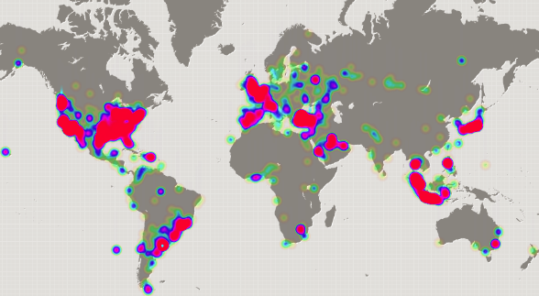
Tweets Originate From Financial Centers
800 million tweets are generated per day worldwide

Slide 4






SMA Partnerships With Industry Leaders
SMA has partnered with Barclays on a family of Structured Products based solely on SMA Data
The CME Group has partnered with SMA to provide Sentiment across 6 Asset Classes and 40 Financial and Commodity Futures
SMA’s sentiment metrics is available to Fidelity’s retail clients through their Active Trader platform and the Mobile App
IHS Markit delivers SMA S-Factors in Daily, 15 Minute, and 1 Minute Feeds as a part of the Research Signals
IHS Markit Develops New Innovative Factors From SMA Content
Partnership to build a family of SMA Sentiment Based Indices
SMLCW went live in January 2017
SMA is a licensed Twitter Partner Warehousing the full Firehose
SMA receives the Twitter stream from GNIP, Twitter’s data division
SMA has been designated as a “Plugged In” Twitter partner

Slide 5
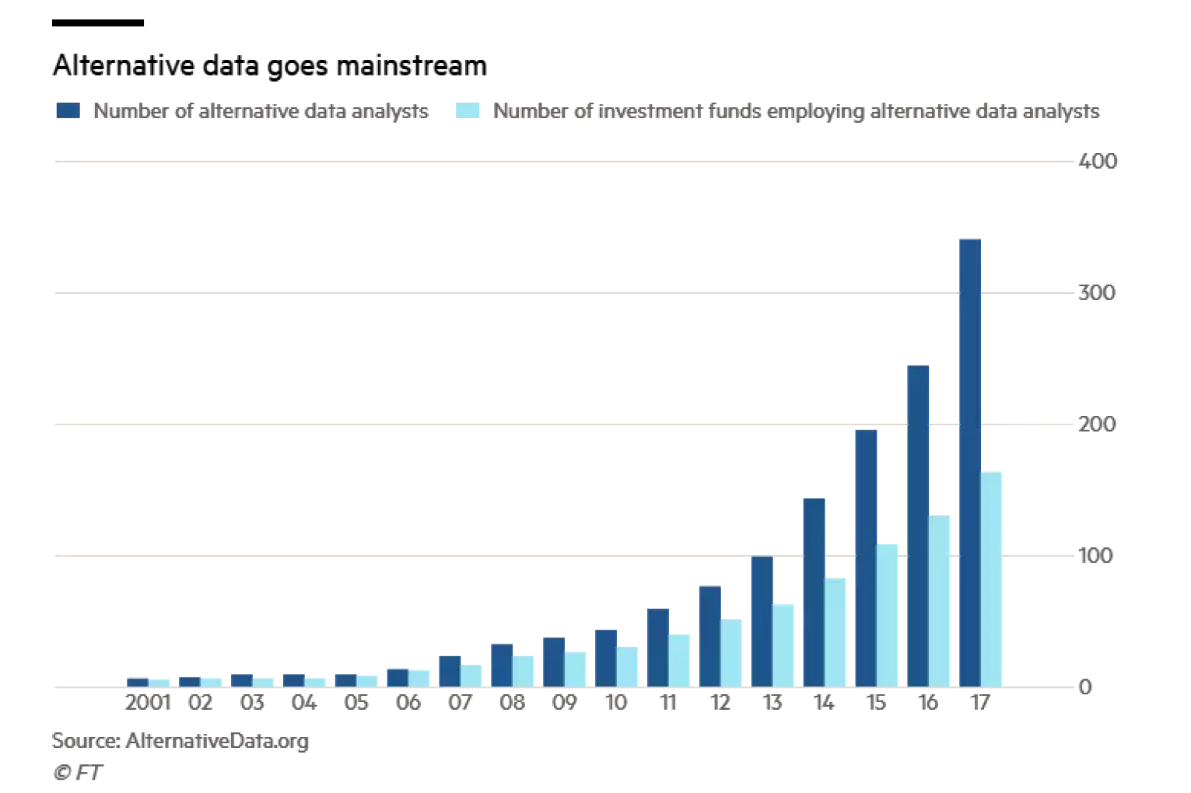
The Growth of Alternative Data

Slide 6
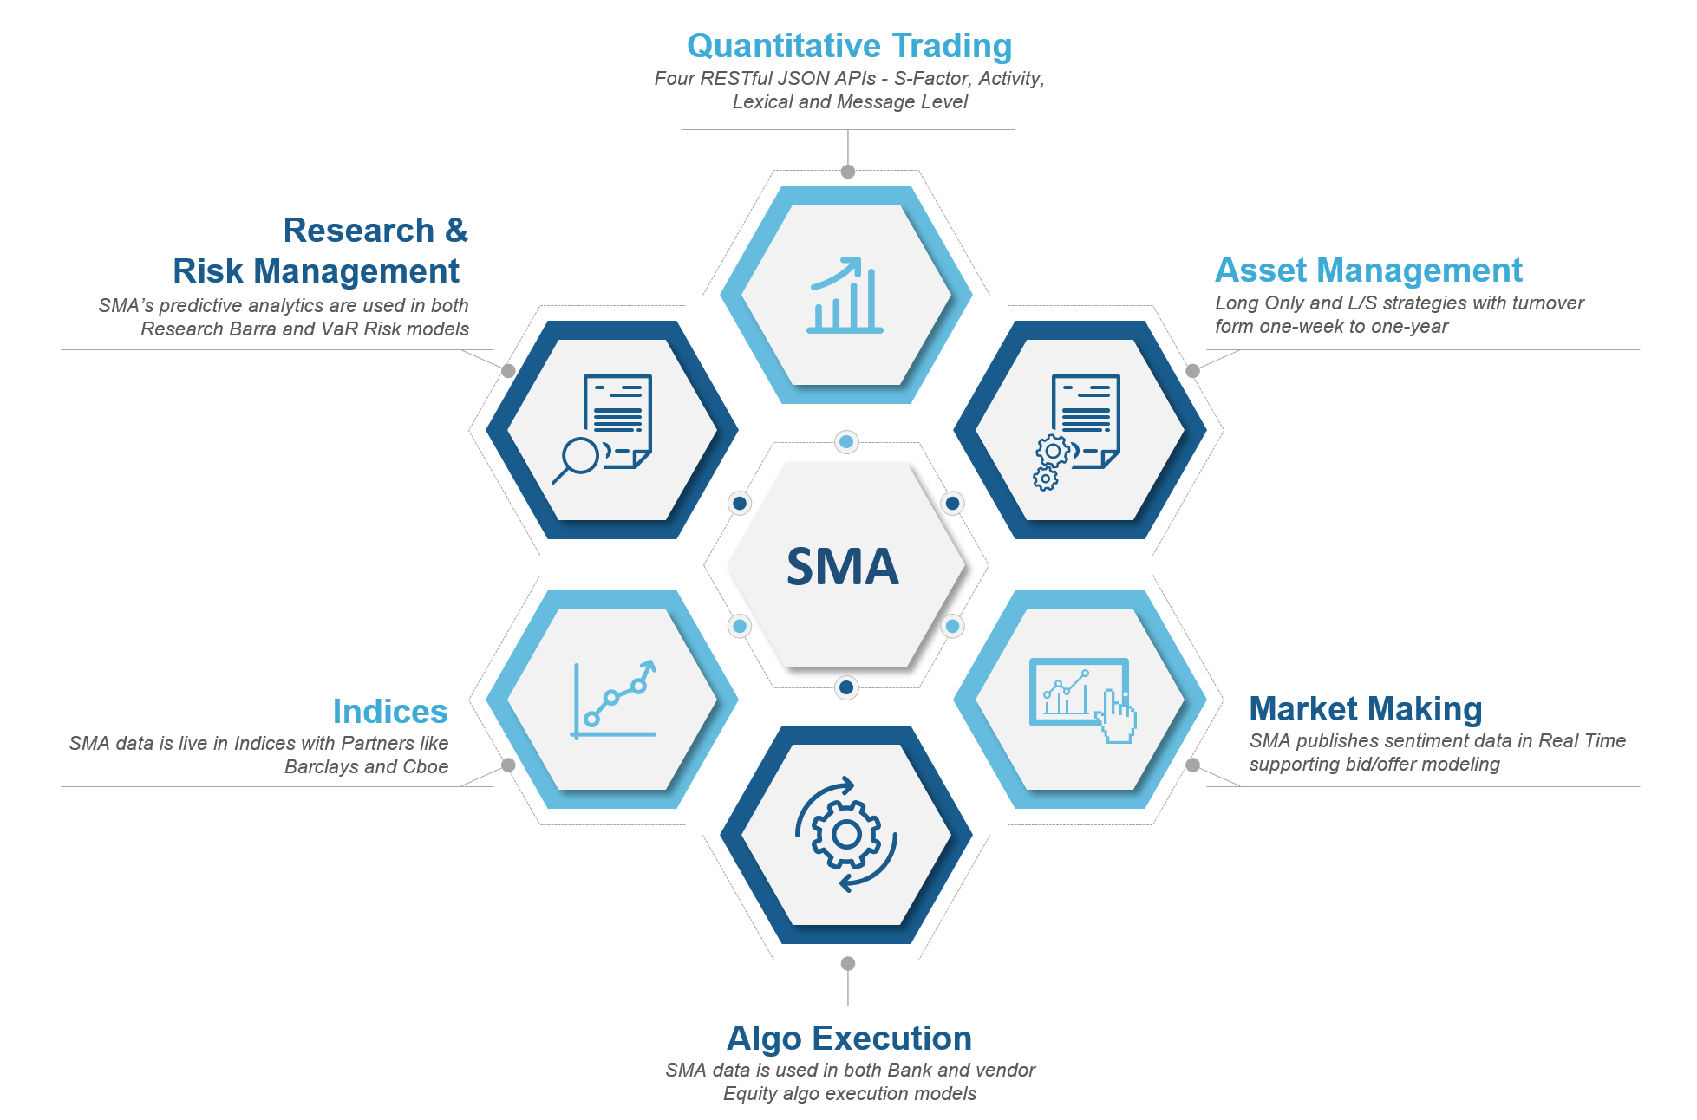
SMA Predictive Data is Used Across Finance

Slide 7

SMA Patented Social Media Framework
SMA Patented Technology
Extractor
Evaluator
Calculator
S-Scores
Extracts All Tweets For Designated Securities
First Filtering
Removes Spam and Assesses Relevance of Data
High Level Filtering
Calculation Engine Quantifies Relevance Based on Indicative Data
Twitter
Firehose
7+ Years
Out of Sample
SMA has two U.S. Patents behind our Process:
Aggregates the intentions of professional investors as expressed on Twitter and StockTwits and other inputs such as earnings call reports, 10K & 10Qs
Calculates Sentiment metrics characterizing the current conversation relative to historical benchmarks

Slide 8
Extractor - Evaluator - Calculator
SMA is the leader in Predictive Analytics behind AI, Machine Learning algorithms and a custom-built finance Natural Language Processor (NLP)
SMA scrubs nearly 1 Billion Textual, Structured and Unstructured Data points daily and Processes, Tags, and Scores as quickly as 3/10th of a second
SMA has warehoused and normalized this data out-of-sample for seven years at the Topic and Security level
SMA eliminates spam. SMA knows the difference between good and bad bots and a good actor and bad actor
SMA’s Topic identification knows the difference between similarly named securities. For example: Ethan Allen Furniture and Ethereum Crypto currency. Both ticker ETH
SMA’s Financial NLP has been developed over seven years of supervised and unsupervised machine learning and uses fine grain scoring
With our patented engine, SMA can turn unused stores of unstructured data into structured data that can be used to enhance Alpha, build Indexes, monitor competitive positioning and Investor Relations

Slide 9
SMA Intellectual Property Advantages
Out of Sample
SMA has 7+ years of out-of-sample data
Ability to delete accounts and Tweets can lead to survivorship bias in other datasets
Account and dictionary changes are applied on a go-forward basis
Natural Language Processing
Scores calculated in real-time 24X7
Fine grain scoring at the Tweet level
Proprietary phrase and word financial dictionary built over seven years
Multi pass approach used in evaluation of each Tweet increases scoring accuracy
Investor Universe
Proprietary algorithms rate and identify professional investors
Research
Independent Research
IHS Markit,
Deutsche Bank
ITG Research
CBOE
SMA Proprietary & Confidential

Slide 10
Four SMA Data Feeds and Security Coverage
SMA delivers data through RESTful JSON APIs 24/7
The data is available in 4 different formats
Securities are identified using multiple identifiers through our NLP developed over the past seven years
The S-Factor data feed aggregates tweets and makes a comparison to baseline to deliver 19 metrics every minute. Snapshots can be requested at different cycles (5m, 15m, Hourly, Daily, etc.) Based on a 24H lookback with a 20D baseline with decay
4,800
US Equities
106
Commodities
The Activity data feed isolates and aggregates information every minute and allows clients to create their own baselines and metrics. Ideal for both HFT for m/m and algo execution and longer baselines for both trading and indices (Weekly, Monthly, Quarterly, Yearly)
47
Currency Pairs
The Tweet Level data feed is tweet level analysis and delivers SMA metrics from our NLP and Account Rating algorithm in 300 milliseconds after receiving the tweet from Twitter
3000
ETF
1000
LSE: FTSE
The Lexical data feed is an enhanced version of the Tweet Level feed. In addition to the sentiment rating and account rating of the tweet, the feed also contains a phrase level break down of tweet along with the sentiment from SMA’s dictionary. This data is delivered in 300 milliseconds after receiving the tweet from Twitter
450+
Crypto Currencies

Slide 11
Predictive Analytics is at the SMA Core
Understanding SMA S-Score
SMA S-Score is one of 15 primary S-Factors delivered through APIs to SMA’s quantitative systemic trading clients. An | S-Score | > 2 represents a Z-Score with a 98.6% probability that the security will subsequently move in the direction of the Sentiment. The standard S-Score is a 24H lookback over a 20D period with decay. Baselines are then created across customized predictive forward periods W, M, Q

Slide 12
SMA S-Score API Provides 15 Data Fields Metrics
S-Score TM
The Normalized Representation Of A Security’s Sentiment Time Series Over A Look Back Period
S-Mean TM
The Average Level Of A Security’s Sentiment Time Series Over A Look Back Period
The Change In A Security’s S-ScoreTM Level At An Observation Time Relative To An Earlier Time
S-Delta TM
S-Volume TM
The Volume Of Indicative Tweets Contributing To A Security’s S-ScoreTM At An Observation Time
SV-Score TM
The Normalized Representation Of A Stock’s Indicative Tweet Volume Time Series Over A Look Back Period
S-Volatility TM
A Measure Of The Variability Of A Stock’s Sentiment Time Series Over A Look Back Period
S-Dispersion TM
A Measure Of The Diversity Of Twitter Sources Contributing To A Security’s S-ScoreTM

Slide 13
Uncorrelated to Existing Factors
Independent verification of uncorrelated nature Social Market Analytics. White Paper: #Alpha-Extracting Market Sentiment From 140 Characters
Extremely Low Correlation With Top Momentum Indicators Indicate SMA S-Factors Are A New And Unique Data Set for Alpha
Factor | Correlation
60-Month Beta | 0.00
5-Day Industry Relative Return | -0.08
Most Recent Earnings Surprise | -0.01
Net Number of Revisions for Fiscal Year 1 | 0.00
ATM Put Volatility – ATM Call Volatility | -0.02
Implied Volatility | 0.06
Short Interest | 0.00
1-Month Change in Short Interest | 0.01

Slide 14
Annualized Returns by Nasdaq Sectors 2011 - 2018
Sector | S-Score > 2 | All Stocks | S-Score < -2
Basic Industries | 20.14% | -0.52% | -16.14%
Capital Goods | 27.03% | 7.11% | 0.67%
Consumer Durables | 16.33% | 8.52% | -1.88%
Consumer Non-Durables | 29.19% | 4.53% | -18.34%
Consumer Services | 17.82% | 5.53% | -2.35%
Energy | 13.91% | -3.92% | -14.52%
Finance | 25.16% | 8.10% | 3.54%
Health Care | 20.34% | 3.89% | -13.68%
Miscellaneous | 29.92% | 3.17% | -17.26%
Public Utilities | 8.41% | 4.77% | -10.02%
Technology | 28.75% | 9.57% | 4.01%
Transportation | 26.93% | 2.44% | -19.13%
SPY | --- | 5.57% | ---
SMA Universe | 22.11% | 6.80% | -8.41%
NA | 20.19% | 2.80% | -5.49%

Slide 15
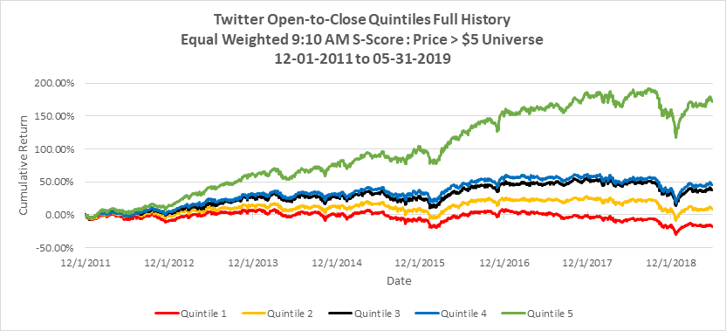
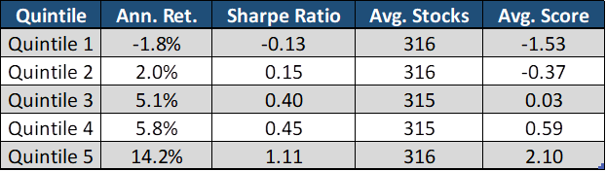
Twitter Quintile: Price > $5 SMA Universe O to C

Slide 16
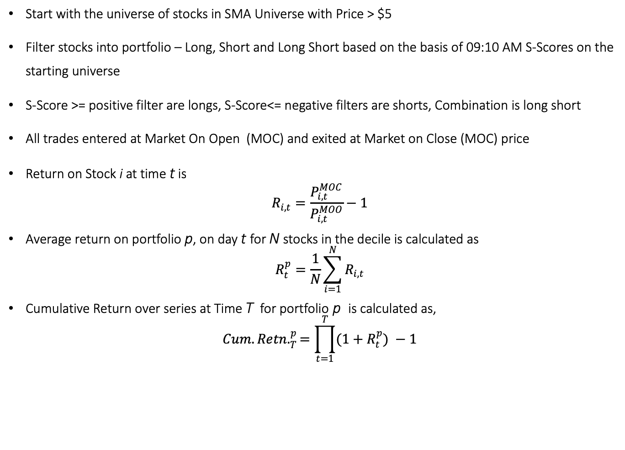
Providing Long and Short Alpha
Start with the universe of stocks in SMA Universe with Price > $5
Filter stocks into portfolio – Long, Short and Long Short based on the basis of 09:10 AM S-Scores on the starting universe
S-Score >= positive filter are longs, S-Score<= negative filters are shorts, Combination is long short
All trades entered at Market On Open (MOC) and exited at Market on Close (MOC) price
Return on Stock i at time t is
$$R_{i,t}=\frac{P_{i,t}^{MOC}}{P_{i,t}^{MOO}}−1$$
Average return on portfolio p, on day t for N stocks in the decile is calculated as
$$R_{t}^{p}=\frac{1}{N}\sum_{i=1}^{N}{R_{i,t}}$$
Cumulative Return over series at Time T for portfolio p is calculated as,
$${Cum.Retn.}_{T}^{p}=\prod_{t=1}^{T}{(1+R_{t}^{p}}) −1$$

Slide 17
Full History - Long/Short
Full History - Long/Short
S-Score | Cum. Rtn. | Sharpe Ratio | Sortino Ratio
S-Score > 2 | 368.53% | 1.62 | 2.69
SPY | 43.94% | 0.51 | 0.78
S-Score < -2 | -59.47% | -0.77 | -1.21
Long/Short | 1016.59% | 4.08 | 8.27

Slide 18
Rolling 1 Year - Long/Short
Rolling 1 Year - Long/Short
S-Score | Cum. Rtn. | Sharpe Ratio | Sortino Ratio
S-Score > 2 | 5.71% | 0.46 | 0.77
SPY | -3.16% | -0.18 | -0.28
S-Score < -2 | -21.69% | -1.50 | -2.29
Long/Short | 34.37% | 4.38 | 9.35

Slide 19
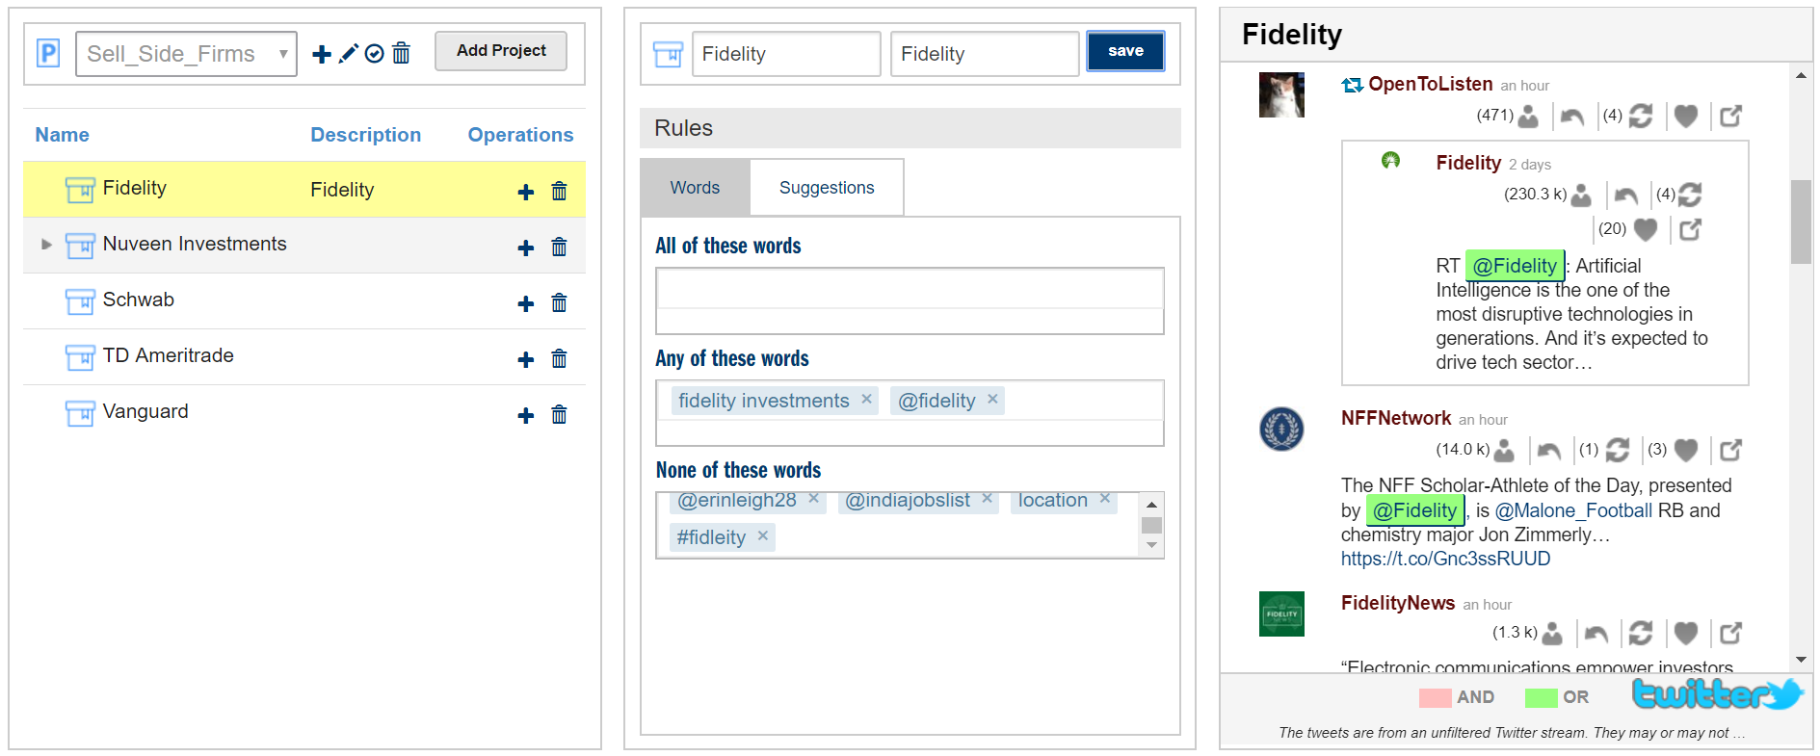
Track any Listed or Private Company or Event
SMA’s Topic Model builds Listed Securities, Private Companies and Macro Events
Machine Learning Rules for Inclusions and Exclusions (NOTs)
Security/Topic Identification through $Tags, #Tags, Products, Subsidiaries, etc.
Block spurious #Tags, Accounts, and NLP from data calculations
Real Time and Historical values
Drill down to individual Tweets and Identify trending Topics

